Slide 1
arcore

Slide 2
기본 세팅
AndroidManifest.xml
<manifest …> … <uses-permission android:name="android.permission.CAMERA" /> <uses-feature android:name="android.hardware.camera.ar" /> <application … <activity …> … </activity> <meta-data android:name="com.google.ar.core" android:value="required" /> </application> </manifest>
build.gradle (:app)
minSdkVersion 24
…
dependencies { … implementation 'com.google.ar:core:1.24.0' }

Slide 3
@Override public void onRequestPermissionsResult(int requestCode, @NonNull String[] permissions, @NonNull int[] grantResults) { super.onRequestPermissionsResult(requestCode, permissions, grantResults); if (!CameraPermissionHelper.hasCameraPermission(this)) { Toast.makeText(this, "Camera permission is needed to run this application", Toast.LENGTH_LONG) .show(); if (!CameraPermissionHelper.shouldShowRequestPermissionRationale(this)) { // Permission denied with checking "Do not ask again". CameraPermissionHelper.launchPermissionSettings(this); } finish(); } }
https://github.com/google-ar/arcore-android-sdk/blob/master/samples/hello_ar_java/app/src/main/java/com/google/ar/core/examples/java/common/helpers/CameraPermissionHelper.java
파일 사용하였음
그냥 샘플코드 퍼왔습니다.

Slide 4
@Override protected void onResume() { super.onResume(); if (session == null) { String message = null; try { switch (ArCoreApk.getInstance().requestInstall(this, !installRequested)) { case INSTALL_REQUESTED: installRequested = true; return; case INSTALLED: break; } // ARCore requires camera permissions to operate. If we did not yet obtain runtime // permission on Android M and above, now is a good time to ask the user for it. if (!CameraPermissionHelper.hasCameraPermission(this)) { CameraPermissionHelper.requestCameraPermission(this); return; } // Create the session. session = new Session(/* context= */ this); } catch (UnavailableArcoreNotInstalledException | UnavailableUserDeclinedInstallationException e) { message = "Please install ARCore"; } catch (UnavailableApkTooOldException e) { message = "Please update ARCore"; } catch (UnavailableSdkTooOldException e) { message = "Please update this app"; } catch (UnavailableDeviceNotCompatibleException e) { message = "This device does not support AR"; } catch (Exception e) { message = "Failed to create AR session"; } if (message != null) { Toast.makeText(this, "TODO: handle exception " + message, Toast.LENGTH_LONG).show(); return; } } try { session.resume(); } catch (CameraNotAvailableException e) { Toast.makeText(this, "Camera not available. Try restarting the app.", Toast.LENGTH_LONG).show(); session = null; return; } glView.onResume(); }
멤버변수
boolean installRequested = false; Session session; 선언
https://developers.google.com/ar/develop/java/enable-arcore
와 샘플 코드 참고함.

Slide 5
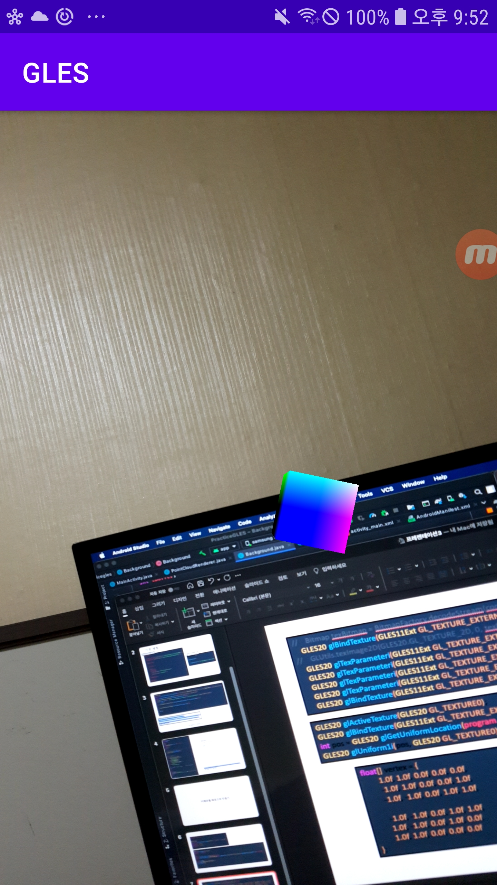
카메라를 배경으로 만들기

Slide 6
int width = 1, height = 1; @Override public void onSurfaceChanged(GL10 gl, int width, int height) { this.width = width; this.height = height;
…
@Override public void onDrawFrame(GL10 gl) { if (session == null) return; try { session.setCameraTextureName(background.texID); session.setDisplayGeometry(((WindowManager) this.getSystemService(Context.WINDOW_SERVICE)).getDefaultDisplay().getRotation(), width, height); session.update(); } catch (CameraNotAvailableException e) { e.printStackTrace(); }
…

Slide 7
// Bitmap texBitmap = BitmapFactory.decodeStream(context.getAssets().open("frame1.png")); GLES20.glBindTexture(GLES11Ext.GL_TEXTURE_EXTERNAL_OES, texID); // GLUtils.texImage2D(GLES20.GL_TEXTURE_2D, 0, texBitmap, 0); GLES20.glTexParameteri(GLES11Ext.GL_TEXTURE_EXTERNAL_OES, GLES20.GL_TEXTURE_WRAP_S, GLES20.GL_CLAMP_TO_EDGE); GLES20.glTexParameteri(GLES11Ext.GL_TEXTURE_EXTERNAL_OES, GLES20.GL_TEXTURE_WRAP_T, GLES20.GL_CLAMP_TO_EDGE); GLES20.glTexParameteri(GLES11Ext.GL_TEXTURE_EXTERNAL_OES, GLES20.GL_TEXTURE_MIN_FILTER, GLES20.GL_LINEAR); GLES20.glTexParameteri(GLES11Ext.GL_TEXTURE_EXTERNAL_OES, GLES20.GL_TEXTURE_MAG_FILTER, GLES20.GL_LINEAR); GLES20.glBindTexture(GLES11Ext.GL_TEXTURE_EXTERNAL_OES, 0);
GLES20.glActiveTexture(GLES20.GL_TEXTURE0); GLES20.glBindTexture(GLES11Ext.GL_TEXTURE_EXTERNAL_OES, texID); int pos = GLES20.glGetUniformLocation(program, "tex"); GLES20.glUniform1i(pos, GLES20.GL_TEXTURE0);
private final String fscode = "" + "#extension GL_OES_EGL_image_external : require\n" + "" + "precision mediump float;" + "" + "uniform samplerExternalOES tex;" + "" + "varying vec2 tc;" + "" + "void main() {" + " gl_FragColor = texture2D(tex, tc);" + "}";
float[] vertex = { 1.0f, 1.0f, 0.0f, 0.0f, 0.0f, -1.0f, 1.0f, 0.0f, 0.0f, 1.0f, -1.0f, -1.0f, 0.0f, 1.0f, 1.0f, -1.0f, -1.0f, 0.0f, 1.0f, 1.0f, 1.0f, -1.0f, 0.0f, 1.0f, 0.0f, 1.0f, 1.0f, 0.0f, 0.0f, 0.0f };
https://github.com/google-ar/arcore-android-sdk/blob/master/samples/hello_ar_java/app/src/main/java/com/google/ar/core/examples/java/common/helpers/DisplayRotationHelper.java
제대로 된 코드는 샘플코드의 updateSessionIfNeeded 참고

Slide 8
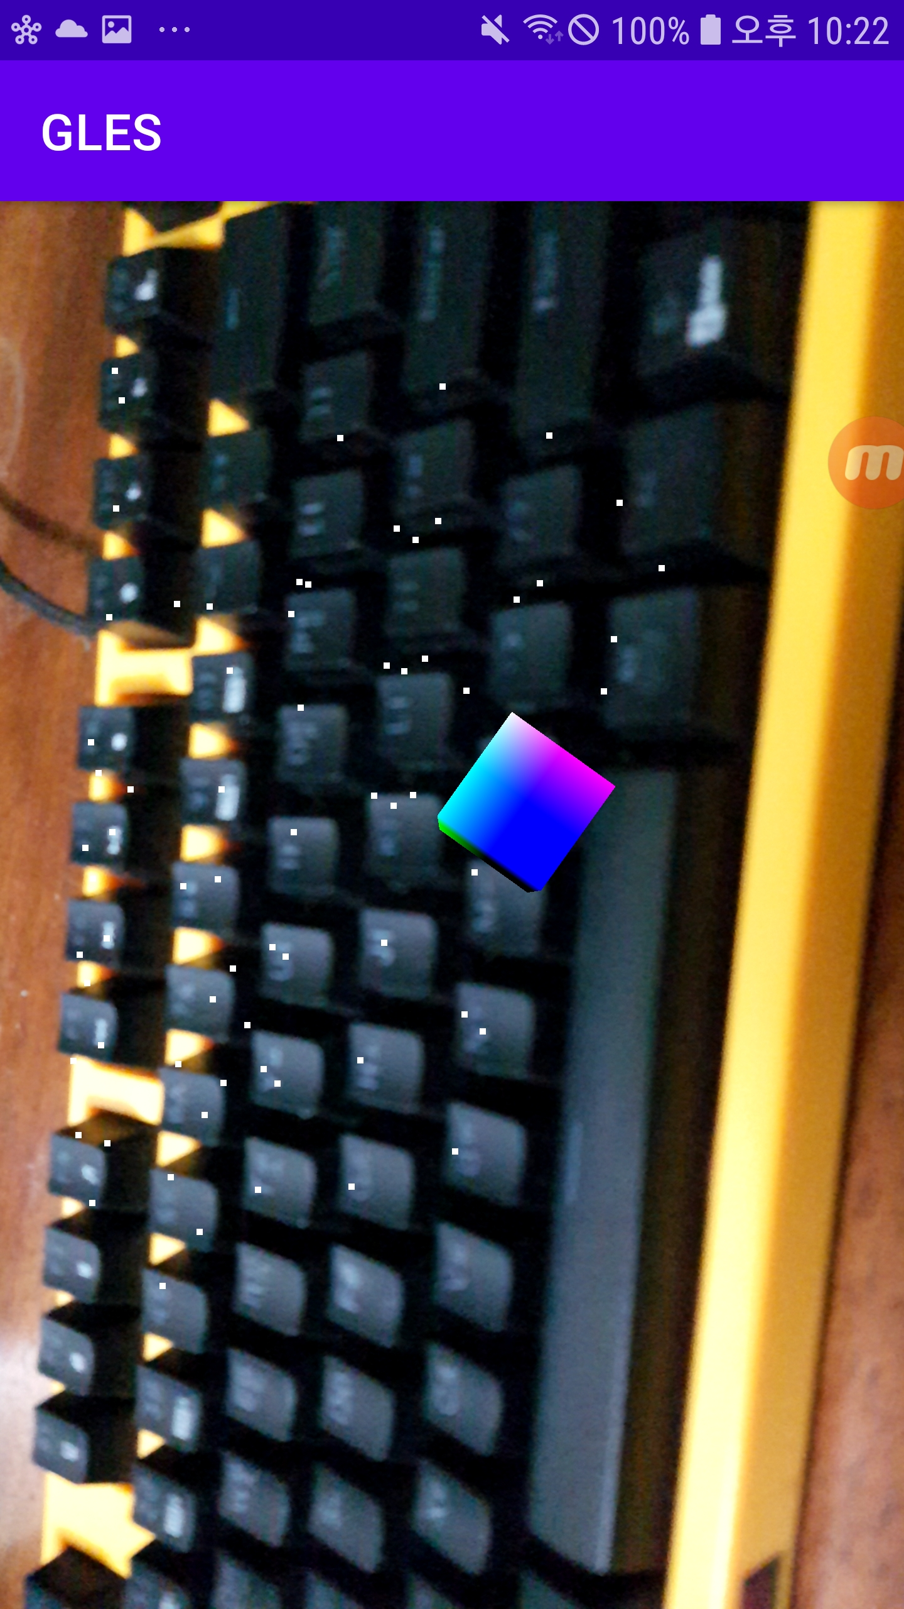
현재 프레임 Point cloud 보여주기

Slide 9
새 파일 PointCloudRenderer.java
private final String vscode = "" + "attribute vec4 vPosition;" + "uniform mat4 viewMX;" + "uniform mat4 projMX;" + "void main() {" + " gl_Position = projMX * viewMX * vec4(vec3(vPosition), 1.0);" + " gl_PointSize = 10.0;" + "}"; private final String fscode = "" + "precision mediump float;" + "void main() {" + " gl_FragColor = vec4(1.0, 1.0, 1.0, 1.0);" + "}";
long lastFrame = 0; int numPoints = 0; public void update(PointCloud pointCloud) { if (lastFrame == pointCloud.getTimestamp()) return; lastFrame = pointCloud.getTimestamp(); numPoints = pointCloud.getPoints().remaining() / 4; GLES20.glBindBuffer(GLES20.GL_ARRAY_BUFFER, vBuffer); GLES20.glBufferData(GLES20.GL_ARRAY_BUFFER, pointCloud.getPoints().remaining() * 4, pointCloud.getPoints(), GLES20.GL_DYNAMIC_DRAW); GLES20.glBindBuffer(GLES20.GL_ARRAY_BUFFER, 0); }
public void draw(float[] viewMX, float[] projMX) { GLES20.glDisable(GLES20.GL_DEPTH_TEST); GLES20.glUseProgram(program); GLES20.glBindBuffer(GLES20.GL_ARRAY_BUFFER, vBuffer); int vPos = GLES20.glGetAttribLocation(program, "vPosition"); GLES20.glEnableVertexAttribArray(vPos); GLES20.glVertexAttribPointer(vPos, 4, GLES20.GL_FLOAT, false, 4 * 4, 0); GLES20.glBindBuffer(GLES20.GL_ARRAY_BUFFER, 0); int pos = GLES20.glGetUniformLocation(program, "viewMX"); GLES20.glUniformMatrix4fv(pos, 1, false, viewMX, 0); pos = GLES20.glGetUniformLocation(program, "projMX"); GLES20.glUniformMatrix4fv(pos, 1, false, projMX, 0); GLES20.glDrawArrays(GLES20.GL_POINTS, 0, numPoints); GLES20.glDisableVertexAttribArray(vPos); GLES20.glEnable(GLES20.GL_DEPTH_TEST); }
public PointCloudRenderer() { int vs = GLES20.glCreateShader(GLES20.GL_VERTEX_SHADER); GLES20.glShaderSource(vs, vscode); GLES20.glCompileShader(vs); int fs = GLES20.glCreateShader(GLES20.GL_FRAGMENT_SHADER); GLES20.glShaderSource(fs, fscode); GLES20.glCompileShader(fs); program = GLES20.glCreateProgram(); GLES20.glAttachShader(program, vs); GLES20.glAttachShader(program, fs); GLES20.glLinkProgram(program); int[] buffers = new int[1]; GLES20.glGenBuffers(1, buffers, 0); vBuffer = buffers[0]; }

Slide 10
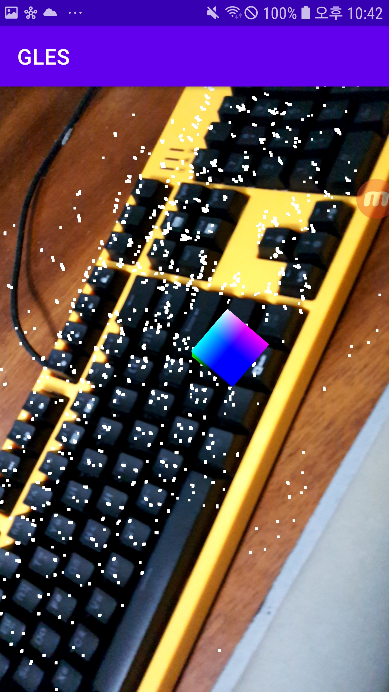
Point cloud 수집하기

Slide 11
멤버변수
boolean isCollecting = true; ArrayList<FloatBuffer> pointList = new ArrayList<>(); 선언
public void fix(ArrayList<FloatBuffer> pointList) { int length = 0; for (FloatBuffer fb : pointList) { fb.position(0); length += fb.remaining(); } FloatBuffer vb = ByteBuffer.allocateDirect(length * 4).order(ByteOrder.nativeOrder()).asFloatBuffer();
for (FloatBuffer fb : pointList) { fb.position(0); vb.put(fb); } vb.position(0); numPoints = length / 4; GLES20.glBindBuffer(GLES20.GL_ARRAY_BUFFER, vBuffer); GLES20.glBufferData(GLES20.GL_ARRAY_BUFFER, vb.remaining() * 4, vb, GLES20.GL_DYNAMIC_DRAW); GLES20.glBindBuffer(GLES20.GL_ARRAY_BUFFER, 0); }
glView.setOnTouchListener((view, event) -> { isCollecting = false; glView.queueEvent(() -> { pointCloudRenderer.fix(pointList); }); return false; });
if (isCollecting) { pointList.add(frame.acquirePointCloud().getPoints()); pointCloudRenderer.update(frame.acquirePointCloud()); } pointCloudRenderer.draw(viewMX, projMX);

